Slide 1
Power bi
It is a business intelligence and visualization tool
By using power bi we can create dashboards and reports

Slide 2
Power bi concepts
Power query editor
Dashboards
Visualizations
Relationships
Dax (Data analysis expresssions )
Bookmarks
Page navigation
Manage roles
Power bi service.

Slide 3
Power query editor
In the power query editor Text column and Number column and date & time column play a key role
Text column:
We can merge the data in power query editor
We can split and Trim the data
We can change by delimiter, like comma, colon, semicolon and space etc.
We do change the Lowercase to upper case
We can add suffix and prefix also

Slide 4
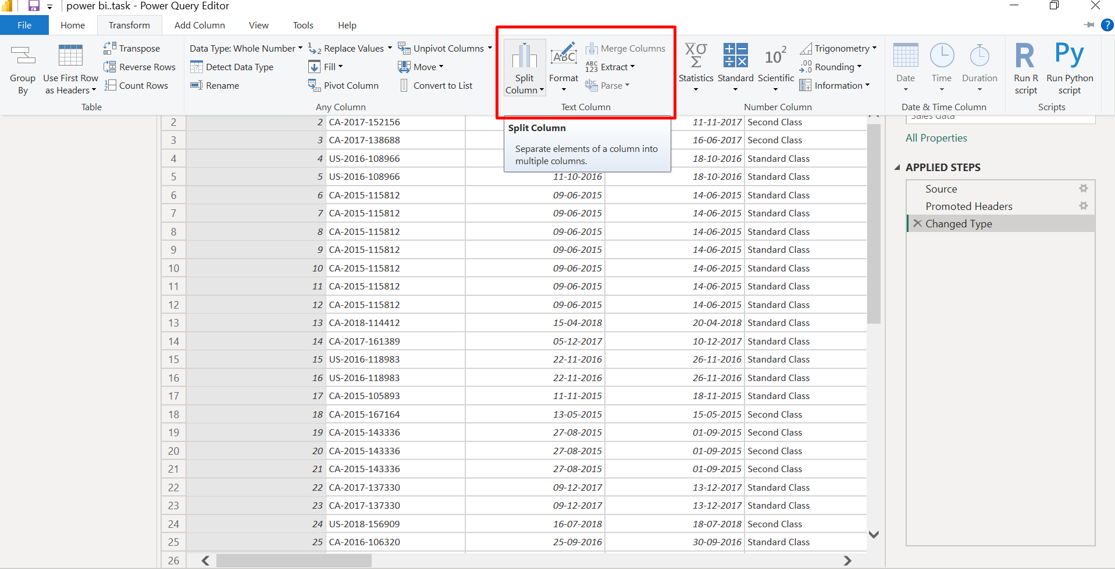
Text column Ex;

Slide 5
Date Function
We can do year, quarter, month, day
We can see year, quarter, month and day
We can see Difference between dates, Earliest and latest
We can see name of day and name of month
And also seen day of Week / Month / Year and Week of Month / Year
We calculate the age

Slide 6
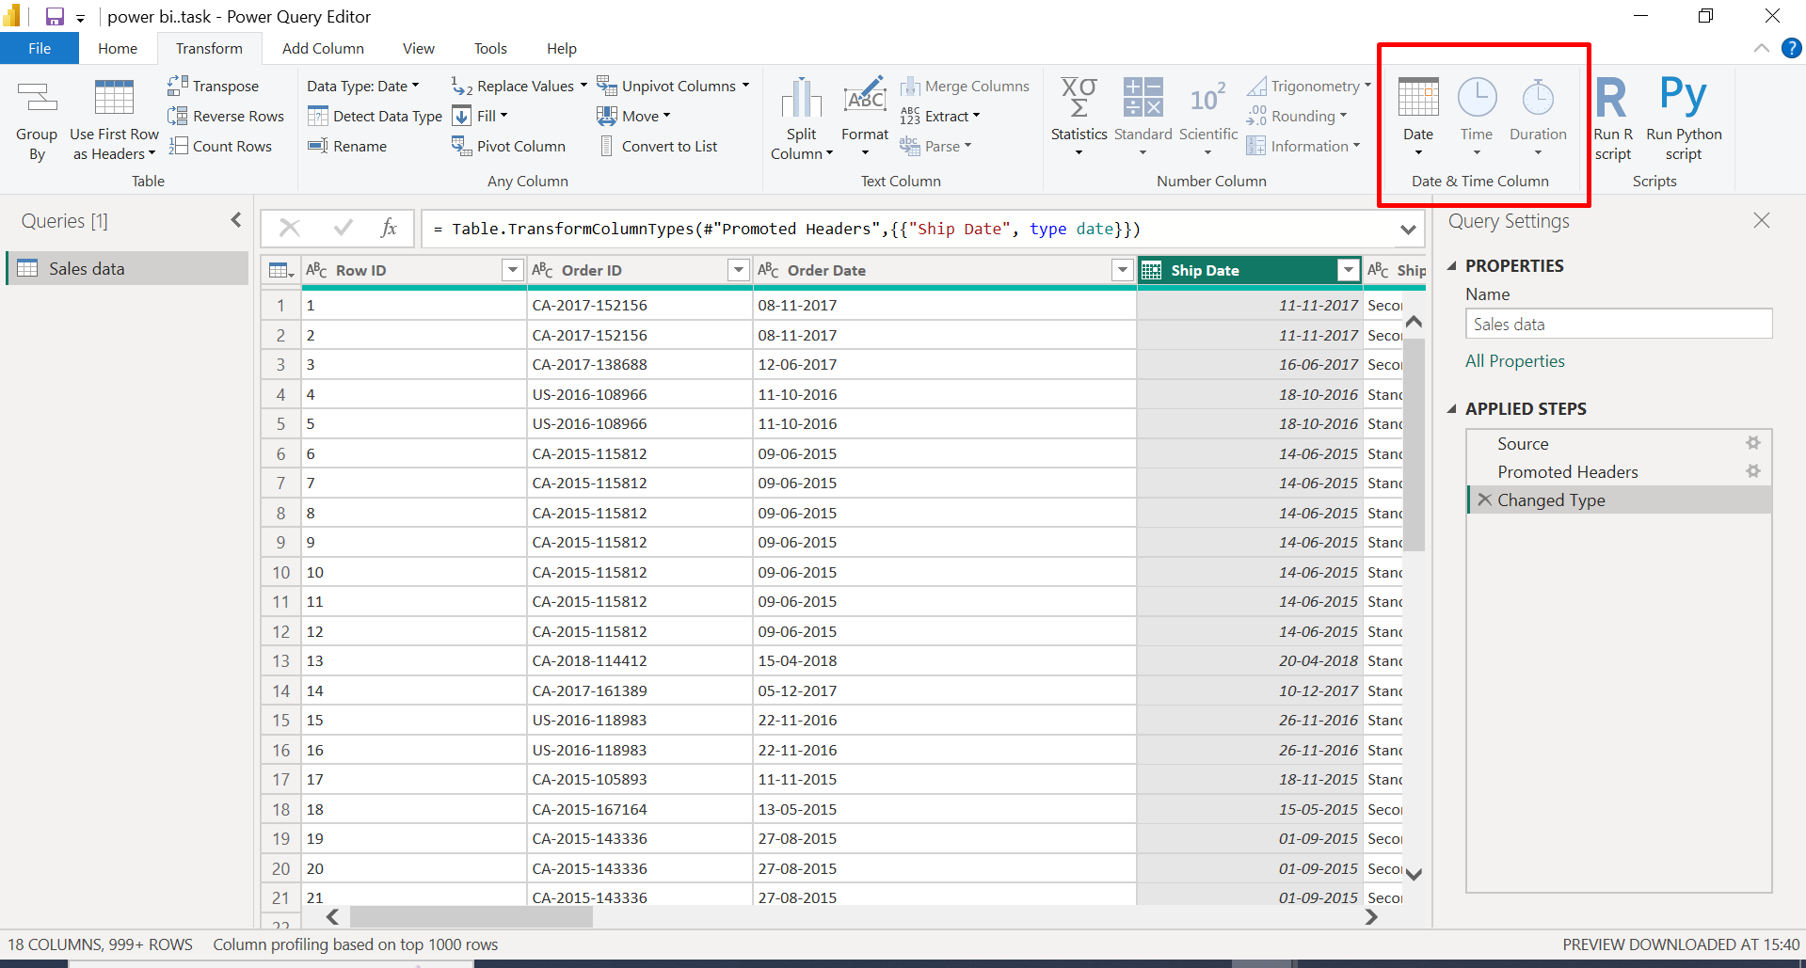
Date Function Ex:

Slide 7
Number column
We can do Add, Subtract Divide and multiply
We can do percentage, Percent of and Modulo
Rounding the numbers
Is even, Is odd and Sign

Slide 8
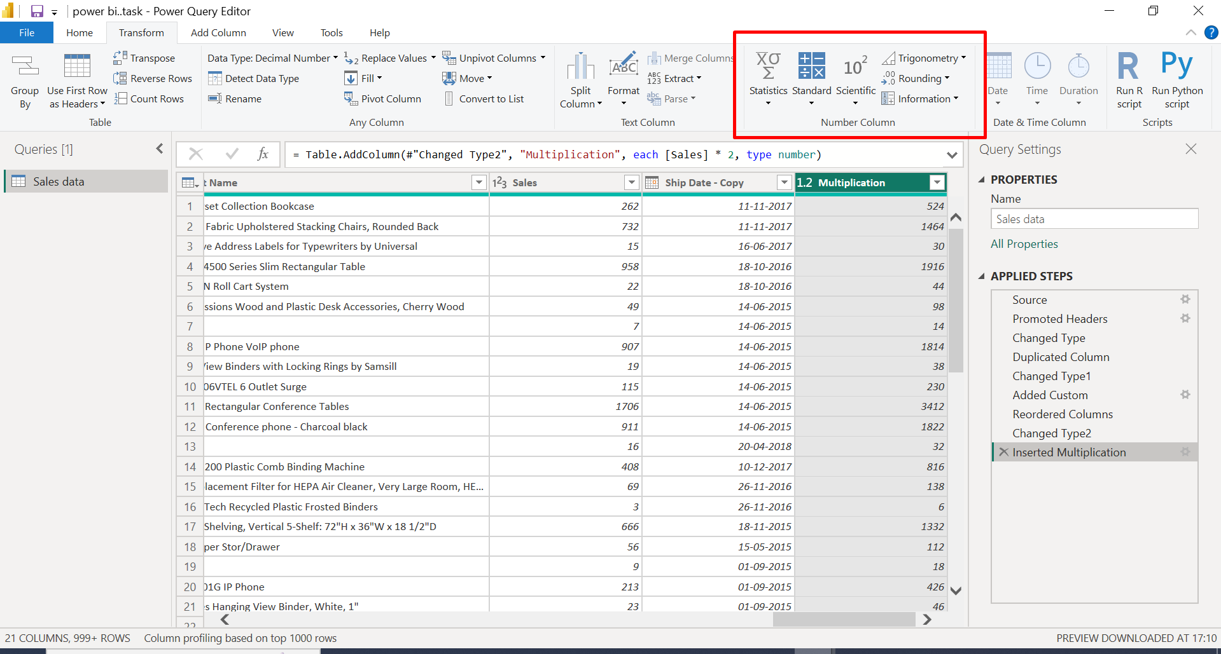
Number column Ex

Slide 9
Dashboards
A single page visualization with multiple charts & graphs to tell a story is called a power bi dashboard
Power bi dashboards are single page documents, often referred to as canvas
This one-page visualization in a dashboard is also known as a canvas
We can create a dashboard on power bi desktop

Slide 10
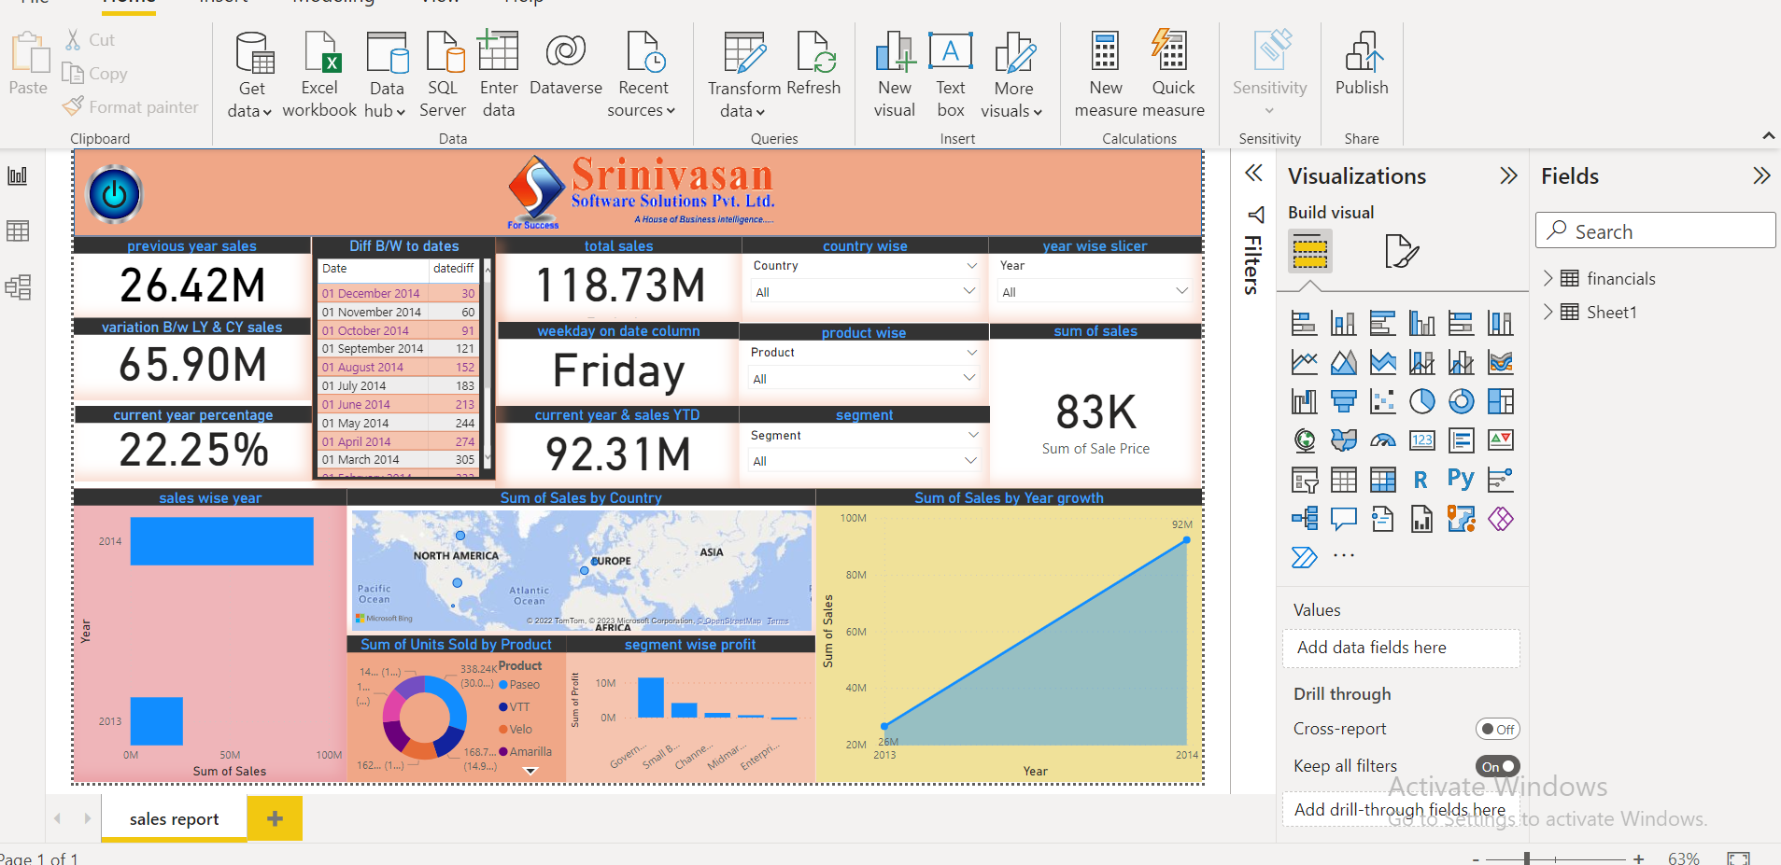
Dashboard Ex:

Slide 11
Visualizations
In visualizations we can show the data in different visuals like Pie chart, Bar chart , Clustered bar chart etc.
We can use colours charts themes shapes
Visualization through visual imagery has been an effective way to communicate in easy manner.

Slide 12
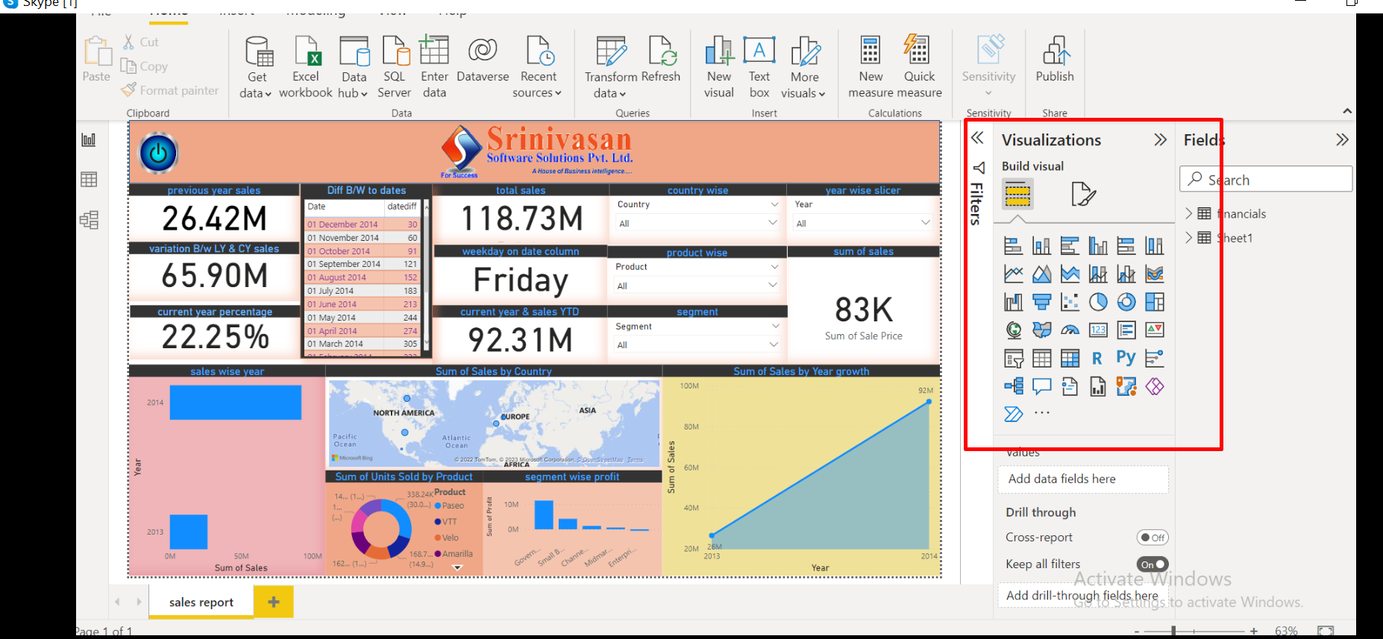
Visualizations
Example:

Slide 13
Relationships
There are three types of relationships between the data you are likely to the design: one-to-one, one-to-many, and many-to-many.
To be able to identify these relationships, you need to examine the data and have an understanding of what business rules apply to the data and tables.

Slide 14
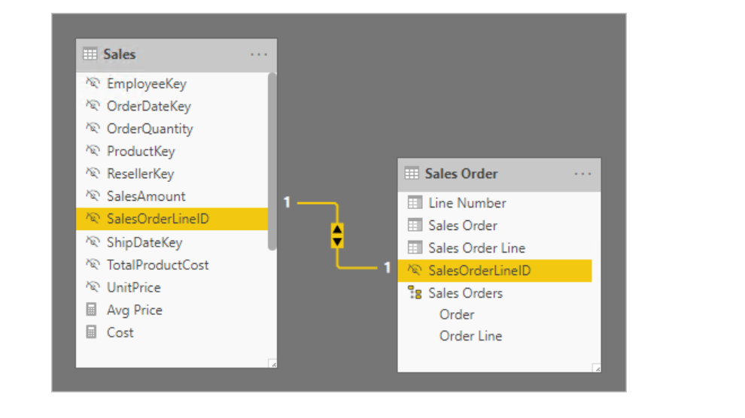
one-to-one
Example

Slide 15
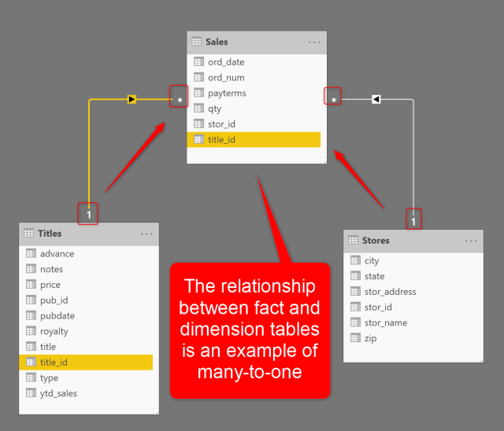
One-to-many
Example

Slide 16
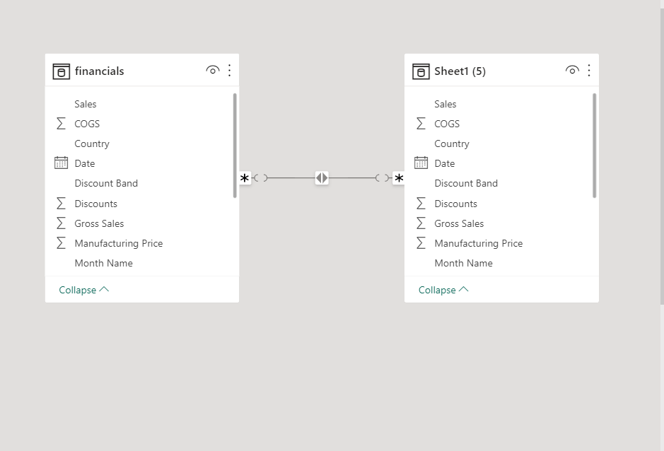
Many-to-Many
Example

Slide 17
Dax (Data Analasis Expressions)
Dax is a programing language .
Dax is used to create calculated columns, measures and custom tables.
Dax is a collection of functions ,operators and constants that can be used in a formula , or expression.
Calculated columns :- we create calculated columns that columns are calculated row by row and it added extra column in the table Arithmetic functions are used in calculated columns.It occupies some space.
Measures:- we create measure on single column only .It does not occupy space. It gives only one value. The measures are only shown in reports, Aggregate functions are used in measures only.

Slide 18
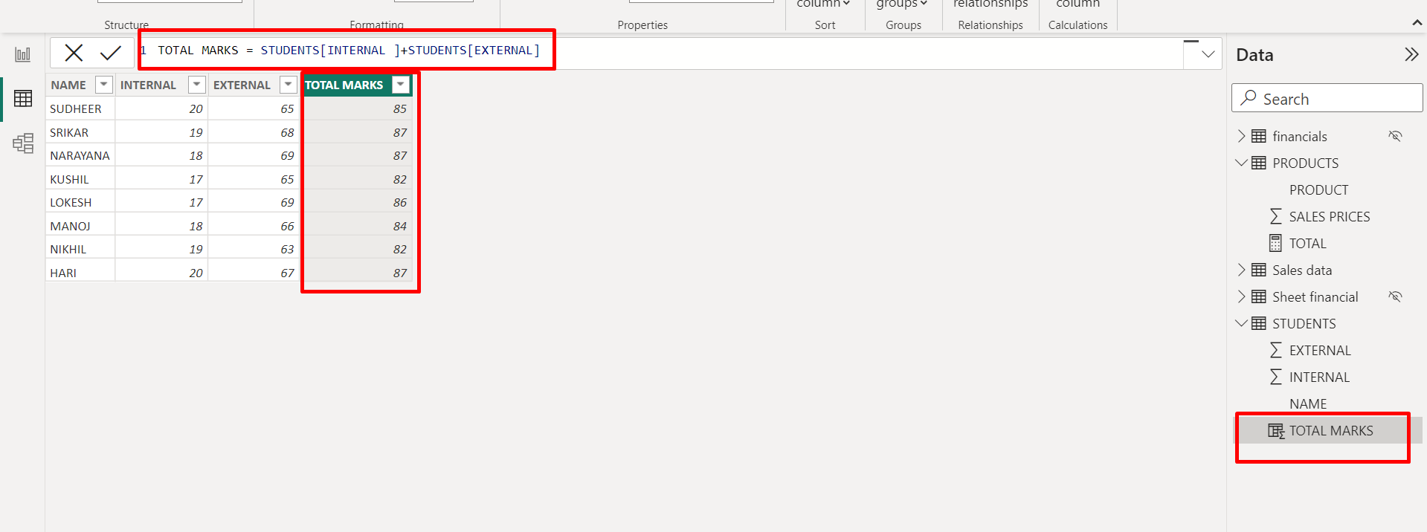
CALCULATED COLUMN EXAMPLE

Slide 19
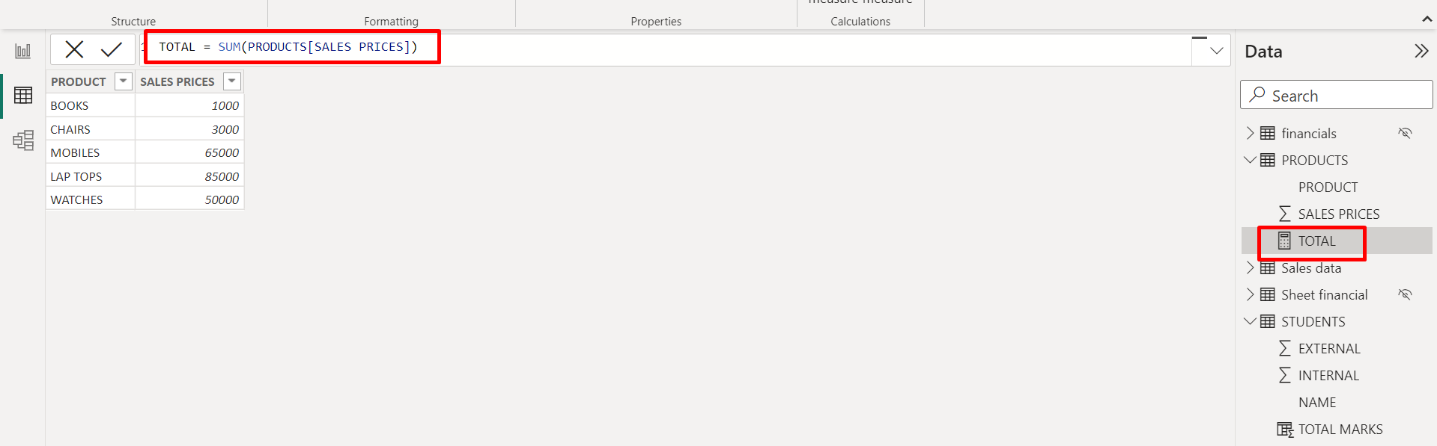
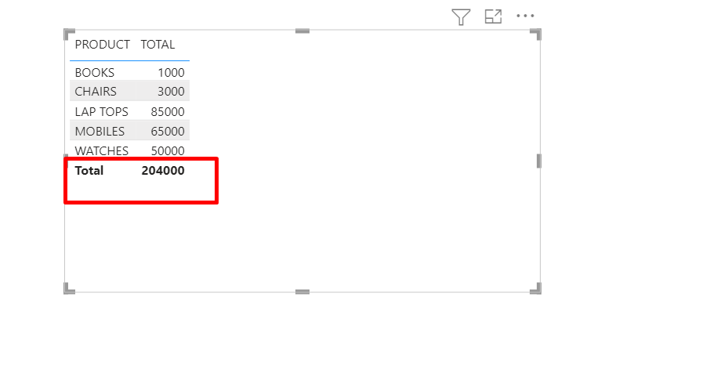
MEASURE EXAMPLE

Slide 20
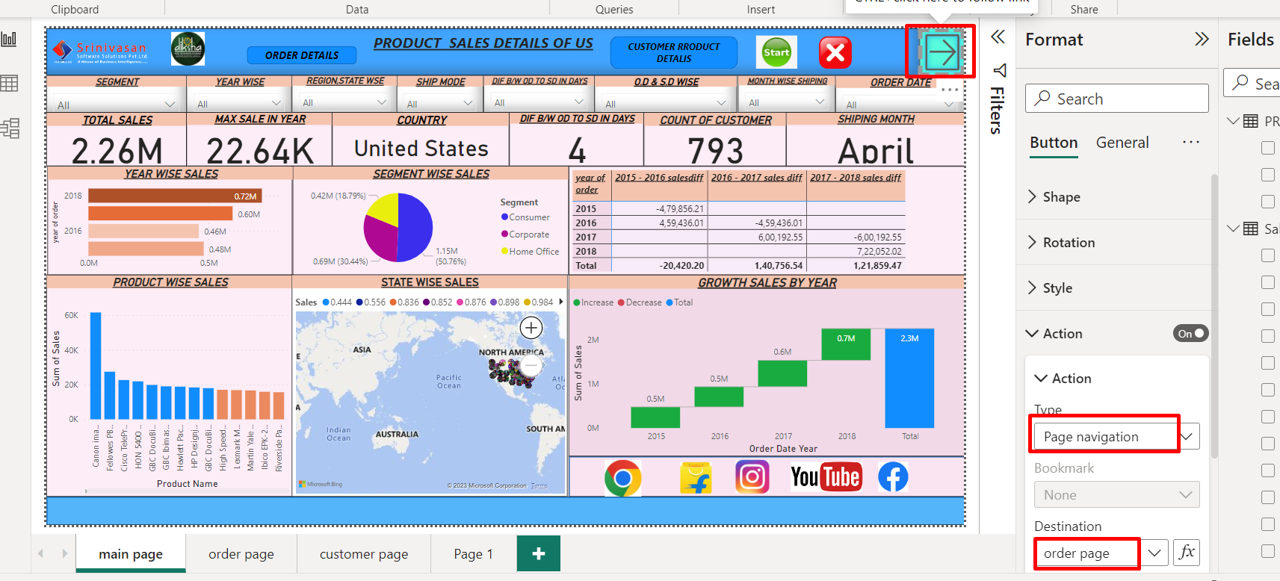
Page navigation
Page navigation is the process of moving between pages in a Power BI report.
All of them generally involve an Action on either a Button, Shapes, or Image.

Slide 21
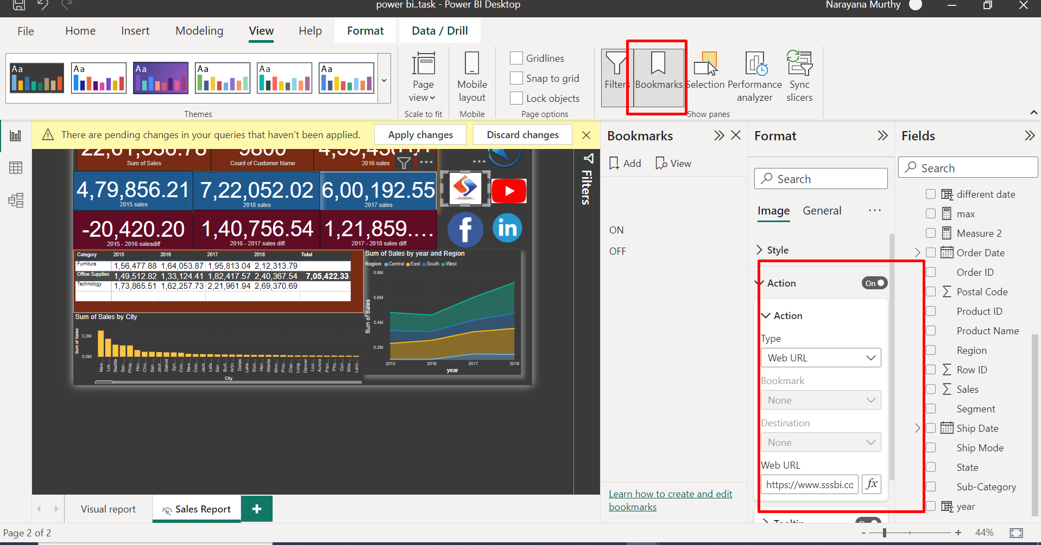
Bookmarks
A ribbon or other marker placed between the pages of a book to mark a place
A link to a website address saved electronically in a browser to facilitate quick access to the web page.
Example

Slide 22
Manage roles
Roles provide a way for community administrators to group permissions and assign them to users or user groups.
Permissions define the actions that a user can perform in a community.
When they assign roles, community administrators consider the tasks of a user in the context of a particular community.

Slide 23
Power bi service
After finishing the dashboards we will shows in publish this report online in the power bi service.
In that publish we have some workspace we save the report on that.

